Slide 1
THN Volunteer HIV Core Training Project
Harm Reduction

Slide 2
Land Acknowledgement
I acknowledge the land I am standing on today is the traditional territory of many nations including the Mississaugas of the Credit, the Anishnabeg, the Chippewa, the Haudenosaunee and the Wendat People and is now the home to many diverse First Nations, Inuit and Métis peoples.
I also acknowledge that Toronto is covered by Treaty 13 signed with the Mississaugas of the Credit, and Williams Treaty signed with multiple Mississaugas and Chippewa bands.
T’karonto is built on sacred land that is part of an agreement between Indigenous peoples and then extended to allied nations to peacefully and respectfully care for it By personally making a land acknowledgement you are taking part in an act of reconciliation, honouring the land and Indigenous heritage, which dates back over 10,000 years.
Notes:
I acknowledge the land I am standing on today is the traditional territory of many nations including the Mississaugas of the Credit, the Anishnabeg, the Chippewa, the Haudenosaunee and the Wendat People and is now the home to many diverse First Nations, Inuit and Métis peoples.
I also acknowledge that Toronto is covered by Treaty 13 signed with the Mississaugas of the Credit, and Williams Treaty signed with multiple Mississaugas and Chippewa bands.
T’karonto is built on sacred land that is part of an agreement between Indigenous peoples and then extended to allied nations to peacefully and respectfully care for it By personally making a land acknowledgement you are taking part in an act of reconciliation, honouring the land and Indigenous heritage, which dates back over 10,000 years.

Slide 3
Acknowledgements
Harm Reduction module task group members from:
Black Coalition for AIDS Prevention (Black CAP)
Queen West Community Health Centre (now Parkdale Queen West)
Ontario HIV Substance Use Training Program (OHSUTP),
Prisoners with HIV/AIDS Support Action Network (PASAN)
Ontario Aboriginal HIV/AIDS Strategy (OAHAS)
Presenter/Facilitator – Kyle Vose, Alex Oberto - Toronto People With AIDS Foundation (PWA)

Slide 4
Learning Objectives:
To increase understanding of the philosophy and practice of Harm Reduction.
To reflect upon, examine and understand our own attitudes and beliefs about people who use substances.
To increase an understanding of the stigma & discrimination faced by people who use substances.
To understand the continuum of substance use and the stages of change.

Slide 5
Notes:
Harm reduction recognizes that there is a continuum of risk in life, as there is in substance use, sex and other activities.
The illness-wellness continuum is a concept used in the field of health and wellness to describe a range of health states that individuals can experience. It illustrates the idea that health is not simply the absence of disease or illness but exists on a spectrum with varying degrees of well-being. The concept emphasizes that individuals can move along this continuum, shifting from states of illness to states of wellness through various factors and behaviors. Here's an overview of the continuum:
1. Illness: On one end of the continuum is illness. This represents a state of poor health, characterized by the presence of disease, symptoms, and a decreased quality of life. It can range from mild, short-term illnesses to severe and chronic conditions.
2. Acute Illness: Acute illnesses are short-term and often have a sudden onset. Examples include the common cold, the flu, and injuries.
3. Chronic Illness: Chronic illnesses are long-term conditions that may or may not have a cure. Examples include diabetes, heart disease, and certain types of cancer.
4. Injury or Disability: This category represents physical injuries or disabilities that affect an individual's overall health and well-being.
5. Recovery: Moving along the continuum from illness, individuals can enter a phase of recovery. This stage indicates a gradual improvement in health, often with the goal of returning to a state of wellness. Recovery may involve medical treatment, therapy, or other interventions.
6. Wellness: On the other end of the continuum is wellness, representing a state of optimal health and well-being. Wellness encompasses physical, mental, and social well-being. It's not just the absence of disease but also the presence of positive factors that promote health.
7. Optimal Wellness: This is the highest level of well-being, where individuals are not just free from illness but actively engage in behaviors that enhance their quality of life. This includes a balanced diet, regular exercise, positive mental health, and strong social connections.
The illness-wellness continuum acknowledges that health is dynamic, and individuals can experience a wide range of health states throughout their lives. It highlights the importance of preventive measures, lifestyle choices, and healthcare access in moving from illness to wellness. Moreover, it underscores that even those with chronic illnesses or disabilities can work towards improving their overall well-being and quality of life.

Slide 6
Non-Judgemental
Notes:
Harm Reduction does not judge individuals on the basis of their individual behaviours

Slide 7
Notes:
Harm reduction recognizes the right for comprehensive, accessible, flexible and culturally responsive non-judgmental social services for and the fulfillment of basic needs of all individuals and communities

Slide 8
What Harm Reduction is NOT
Abstinence -Only
Legalization Advocacy:
A Substitute for Treatment:
Promotion of Drug Use
One-Size-Fits-All:
Ignoring Social Context:
Indifference to Health
Enabling or Encouraging Risky Behavior
A Quick Fix:
Notes:
Harm reduction is a specific approach to addressing risky behaviors, particularly related to substance use, but it's essential to understand what harm reduction is not:
Abstinence-only: Harm reduction is not an abstinence-only approach. It doesn't require individuals to completely abstain from substance use or other risky behaviors. Instead, it aims to reduce harm and promote safer practices, even for those who continue to engage in these behaviors.
Promotion of Drug Use: Harm reduction does not promote or endorse drug use or other risky behaviors. Rather, it recognizes that these behaviors exist and seeks to mitigate their negative consequences.
Indifference to Health: It is not an approach that ignores health concerns. Instead, harm reduction focuses on improving health outcomes and reducing risks associated with behaviors, even when those behaviors persist.
Legalization Advocacy: While harm reduction may intersect with drug policy discussions, it is not primarily a stance on drug legalization. It is a public health and pragmatic approach aimed at minimizing harm, rather than a political or legal stance.
One-Size-Fits-All: Harm reduction is not a uniform set of strategies applied the same way in all situations. It is flexible and can be tailored to specific communities and their needs.
Enabling or Encouraging Risky Behavior: Critics sometimes argue that harm reduction might enable or encourage risky behavior. However, proponents of harm reduction argue that by providing support, education, and safer alternatives, it can actually motivate some individuals to reduce or quit their risky behaviors.
A Substitute for Treatment: Harm reduction is not a replacement for treatment or recovery programs. In fact, it can be a bridge to connect people with treatment services when they are ready to seek help.
Ignoring Social Context: Harm reduction recognizes the social and economic factors that contribute to risky behaviors but does not ignore these aspects. In fact, it often addresses these issues as part of its strategies.
A Quick Fix: Harm reduction is not a quick or simple solution. It's a long-term approach that aims to gradually reduce harm, improve health outcomes, and create safer communities.
It's important to understand that harm reduction is a harm minimization strategy rooted in public health and compassion. It seeks to address the complex and multifaceted nature of risky behaviors while respecting individual autonomy and dignity.

Slide 9
Stigmatizing Language
Drunks”, “Alcoholics” >>>
Druggies”, “Junkies”, “Crack Heads”
Drug Abuse”, or “Substance Abuse”
Preferred Language
Individuals with problem alcohol use or “Alcohol users
people who use drugs” “a person living with an addiction” or “active substance user”
Substance use” “Problem Substance Use”
“clean”, “dirty”
“new or used” equipment
Notes:
What is stigmatized language?​
What is stigmatizing language? Stigmatizing language assigns negative labels, stereotypes, and judgment to certain groups of people. Such language can contribute to negative outcomes such as social isolation, reduced self-esteem, and less likelihood to seek medical help.​
​
Ask the participants to think about all the derogatory labels that they may have heard used to describe people living with alcohol/drug issues​
​
“Alcoholics”, “Drunk” Individuals with problem alcohol use or “Alcohol users”, “substance user”.​
​
“Druggies”, “Junkies”, “Crack Heads” people who use drugs” “a person living with an addiction” or “active substance user”​
​
“Drug Abuse”, or “Substance Abuse” “Substance use” “Problem Substance Use”.​
​
“clean”, “dirty” new or used” equipment

Slide 10
AIVL AUSTRALIAN STIGMA & DISCRIMINATION OF INJECTION DRUG USERS
https://www.youtube.com/watch?v=ASoKlgsZPCk

Slide 11
Social Determinants of Health:
Economic Stability
Education Access and Quality
Vulnerability to Substance Use:
Social Pressures
Mental Health
Vulnerability to HIV Infection:
Lack of Education
Poverty and Homelessness
Neighborhood and Physical Environment
Healthcare Access and Quality
Social and Community Context
Trauma
Social Isolation
Poverty
Stigma and Discrimination
Unsafe Practices
Limited Access to Healthcare
Notes:
Social Determinants of Health:
These are conditions in the environments where people are born, live, learn, work, and play that affect a wide range of health, functioning, and quality-of-life outcomes and risks.
Economic Stability: Having a stable income and resources to meet your needs.
Education Access and Quality: Access to quality education and lifelong learning opportunities.
Neighborhood and Physical Environment: Safe and clean surroundings, including access to parks, grocery stores, and healthcare facilities.
Social and Community Context: Relationships, community engagement, social support systems, and levels of discrimination.
Healthcare Access and Quality: Access to healthcare services, including preventive, emergency, and specialty care.
Vulnerability to Substance Use:
Social Pressures: Peer pressure and social norms that encourage or accept substance use.
Mental Health: Issues like anxiety or depression can make people more vulnerable.
Trauma: Previous traumatic experiences can lead to using substances as a coping mechanism.
Social Isolation: Lack of social support or feeling disconnected from others can increase vulnerability.
Poverty: Individuals in poverty may turn to substances due to stress or lack of resources.
Vulnerability to HIV Infection:
Lack of Education: Limited knowledge about HIV transmission and prevention methods can increase vulnerability.
Poverty and Homelessness: Limited access to healthcare and safe living conditions.
Stigma and Discrimination: Fear of judgment can prevent people from seeking HIV testing and care.
Unsafe Practices: Engaging in unprotected sex or sharing needles significantly increases vulnerability.
Limited Access to Healthcare: Inadequate access to HIV testing, treatment, and prevention services.
Understanding these social determinants can help tailor interventions and policies to address the specific vulnerabilities individuals face regarding substance use and HIV infection

Slide 12
Personal Factors:
Low Self-Esteem
Self-Medication
Peer Pressure
Systemic Factors:
Socioeconomic Inequality:
Systemic Discrimination
Lack of Access to Support Services
Cultural and Societal Norms
Notes:
People may turn to drug use for a variety of personal and systemic reasons, and self-worth and self-esteem can be significant influences in this regard. Here's a breakdown of how self-worth and self-esteem can affect drug use:
Personal Factors:
1. Low Self-Esteem: Individuals with low self-esteem might use drugs as a way to cope with feelings of inadequacy or to temporarily boost their self-worth. The effects of certain substances can provide a temporary sense of confidence or self-assuredness.
2. Self-Medication: Some individuals with low self-esteem may use drugs to self-medicate for emotional or psychological issues, such as depression, anxiety, or trauma. They might believe that substances help them feel better about themselves or numb emotional pain.
3. Peer Pressure: Low self-esteem can make individuals more susceptible to peer pressure. They might use drugs to fit in with a social group, seeking external validation to boost their self-worth.
Systemic Factors:
1. Socioeconomic Inequality: Living in impoverished communities or experiencing socioeconomic disparities can affect self-worth. Substance use might be seen as a way to escape the challenges and hardships associated with low socioeconomic status.
2. Systemic Discrimination: Systemic discrimination based on race, gender, sexual orientation, or other factors can erode self-esteem. Individuals might use drugs to cope with the stress and discrimination they face.
3. Lack of Access to Support Services: A lack of access to mental health services or other support systems can limit opportunities for individuals to address underlying self-worth issues in healthier ways, potentially leading to substance use.
4. Cultural and Societal Norms: Cultural or societal norms that glorify or romanticize substance use can influence self-esteem. For example, if a culture glamorizes the use of certain drugs, individuals might perceive using them as a way to gain social status or self-worth.
Addressing the complex relationship between self-worth, self-esteem, and drug use requires a multi-faceted approach that involves personal, community, and systemic interventions. Encouraging positive self-esteem and providing support for mental health and coping strategies can help individuals avoid or overcome substance use driven by self-worth issues. Additionally, addressing systemic factors like poverty, discrimination, and limited access to support services can help create environments where people are less vulnerable to using drugs as a means of boosting self-worth.

Slide 13
Key Elements of Drug Related Stigma Incarceration
Legal Consequences
Racial Disparities
Social Perception
Discrimination
Economic
Costs
Alternatives
Limited Rehabilitation
Public Policy
Criminalization vs. Public Health
Cycle of Stigma
Notes:
Criminalise
drugs = bad get tough punish.
Incarcerating users for non-violent crime vs. resources into supportive services.
Drug-related stigma and incarceration are closely linked, as drug use and non-violent drug offenses often lead to stigmatization and imprisonment. Here are key elements of the relationship between drug-related stigma and incarceration:
1. Social Perception: Drug-related stigma involves negative perceptions and stereotypes about people who use drugs. They are often seen as morally flawed, unreliable, or dangerous, contributing to a perception that they deserve punishment.
2. Legal Consequences: Stigmatization can lead to punitive drug laws and policies that criminalize drug possession and use, even for non-violent offenses. This results in the arrest, prosecution, and incarceration of individuals with substance use issues.
3. Discrimination: Stigmatization can create a climate of discrimination against people who use drugs. This discrimination can extend beyond the criminal justice system to affect housing, employment, and access to healthcare and social services.
4. Racial Disparities: Drug-related stigma and punitive drug policies have contributed to racial disparities in the criminal justice system. Minority communities are often disproportionately impacted, leading to higher rates of arrest and incarceration among people of color.
5. Public Policy: Stigmatization has influenced public policy, contributing to a "War on Drugs" mentality that emphasizes punishment and imprisonment over harm reduction, treatment, and prevention.
6. Cycle of Stigma: Incarceration can exacerbate drug-related stigma, as individuals with criminal records often face additional barriers to finding employment and housing, increasing their vulnerability to relapse and recidivism.
7. Limited Rehabilitation: Prisons and jails may lack comprehensive rehabilitation programs, making it difficult for incarcerated individuals to address the root causes of their substance use issues.
8. Economic Costs: Incarceration is expensive, with taxpayer money spent on housing, feeding, and providing healthcare for inmates, which could potentially be redirected to more effective prevention and treatment programs.
9. Alternatives: Advocates for reform argue that alternatives to incarceration, such as diversion programs, treatment courts, and supportive services, can be more effective in addressing the underlying causes of substance use while reducing stigma.
10. Criminalization vs. Public Health: The debate between punitive criminalization and a public health approach focuses on whether drug use should be treated primarily as a criminal issue or as a public health concern, emphasizing prevention, harm reduction, treatment, and recovery support.
Understanding these key elements is crucial for addressing the complex relationship between drug-related stigma and incarceration and for promoting more compassionate, evidence-based, and cost-effective responses to substance use issues.
.
Most prisoners admit to having a substance use issue that would warrant treatment while in prison
Disproportionate representation of Aboriginal peoples inside due to systemic discrimination, socio-economic deprivation and other factors
Most incarcerated women are survivors of childhood sexual abuse and/or domestic violence, and many women have been economically, racially, culturally, and sexually marginalised.
Prisoners’ health is directly related to community health.
Prisoners have had a series of events that lead up to them being incarcerated.
People need community waiting for them so they don’t have to go back in to find it.

Slide 14
D
Notes:
Use this model as an example to show where on this model for three or four different substances where a person may fall.
The drug use continuum is a spectrum that represents various stages and patterns of substance use, from no use to problematic use or addiction. Understanding this continuum helps in assessing and addressing substance use issues effectively. Here's a simplified overview:
1. Non-Use: At one end of the continuum is complete non-use, where an individual has never used drugs or has abstained from drug use.
2. Experimental Use: Some individuals experiment with drugs out of curiosity or peer pressure. This may involve trying a substance once or infrequently.
3. Recreational Use: People in this category use drugs occasionally for enjoyment or in social settings, without significant negative consequences or dependence.
4. Regular Use: Regular use involves consistent drug use without immediate adverse effects or dependency. Individuals may use substances for various reasons, such as relaxation or coping.
5. Harmful Use: At this stage, drug use begins to have negative consequences, like health problems, relationship strains, or work-related issues. Individuals may not be addicted but are experiencing harm.
6. Problem Use: Problematic use indicates that substance use is causing significant harm and negative consequences. It may involve loss of control, failed attempts to cut down, and ongoing use despite problems.
7. Dependence/Addiction: This is the most severe stage, characterized by physical and psychological dependence on the substance. Individuals often prioritize drug use over other aspects of their life, leading to severe negative consequences.
8. Recovery: For some, recovery is possible, representing a shift away from problematic use or addiction. It involves abstinence or controlled use with positive lifestyle changes and support.
9. Relapse: Relapse refers to returning to problematic use after a period of abstinence or controlled use. It's a common part of the recovery process for many individuals.
Understanding where individuals fall on this continuum is crucial for tailoring interventions and support. It's important to approach each stage with appropriate harm reduction or treatment strategies, focusing on the individual's unique needs and goals.

Slide 15
Stages of Change Model
Notes:
Use an example like dieting or quite smoking. Remember relapse can happen at every and any stage!
The Stages of Change Model is a way to understand how people change their behaviour. It has six main stages:
1. Not Ready: People don't want to change.
2. Thinking About It: People are considering change but haven't started.
3. Getting Ready: They're preparing for change.
4. Taking Action: People are actively changing their behaviour.
5. Staying Changed: They work to keep the new behaviour.
6. Slipping Back: Sometimes, people go back to the old behaviour.
Each stage helps professionals figure out how to best help someone make a change.
Formal Definition
The Stages of Change Model, also known as the Transtheoretical Model, is a psychological framework developed by James Prochaska and Carlo DiClemente in the late 1970s. It describes the process individuals go through when making a behaviuor change, including changes related to substance use. The model recognizes that change is a process, not an event, and it provides insights into how individuals move from one stage to another. The stages in this model are:
1. Precontemplation: In this stage, individuals are not yet considering change. They may be unaware of the problem, in denial, or not see it as a concern. People in this stage are not actively considering change within the next six months.
2. Contemplation: At this stage, individuals recognize the issue and are considering making a change. They are more aware of the pros and cons of change but have not committed to taking action in the near future.
3. Preparation: In this stage, people are actively preparing for change. They may be setting goals, seeking information, and planning to take action soon, often within the next month.
4. Action: In the action stage, individuals have taken specific steps toward behavior change. They are making noticeable efforts to address the problem, such as attending counseling, participating in a treatment program, or actively avoiding the substance of abuse.
5. Maintenance: After successfully making changes, individuals enter the maintenance stage. They are working to maintain their new behaviors and prevent relapse. This stage can extend for an indefinite period.
6. Relapse: Relapse is considered a part of the process. It's when individuals return to their previous behavior after a period of change. This can happen at any stage but is most common in the action and maintenance stages. Importantly, relapse doesn't mean failure; it's an opportunity to learn and renew the commitment to change.
7. Termination/Adoption: Some models include a seventh stage, where individuals have fully integrated the new behavior into their life, and the old behavior is no longer a temptation. Not everyone reaches this stage, especially in the context of addiction.
The Stages of Change Model is widely used in healthcare and psychology to understand and support behavior change in various contexts, including substance use. It helps professionals tailor interventions to an individual's current stage of change and recognize the challenges associated with each stage.

Slide 16
Notes:
Explain how changing one of these can change how the drug can affect a person
Drug: Set: Setting is a framework used to understand and describe the factors that influence a person's drug experience:
1. Drug: This refers to the substance being used. Different drugs have different effects on the mind and body. The type of drug, its dosage, and purity all play a significant role in the experience.
2. Set: This refers to the individual's mindset or psychological state. Factors in the "set" include their current emotional state, expectations, mental health, and past experiences. An individual's mindset can greatly impact how they perceive and react to the drug.
3. Setting: This refers to the physical and social environment in which the drug is used. The setting encompasses the physical location, the people present, and the cultural and legal context. The setting can influence the overall experience and determine whether it's positive or negative.
Understanding the interplay between these three elements is important, especially in the context of psychedelic substances. A positive "set and setting" can contribute to a safe, meaningful, and transformative experience, while a negative or uncomfortable set and setting can lead to anxiety, paranoia, or challenging experiences.
This concept underscores the significance of responsible drug use, education, and harm reduction. It encourages individuals to carefully consider their mental and emotional state, the physical environment, and the social context before using substances, particularly those that can alter perception and cognition significantly.

Slide 17
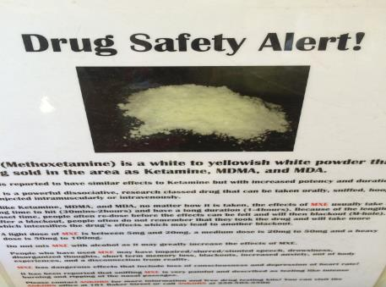
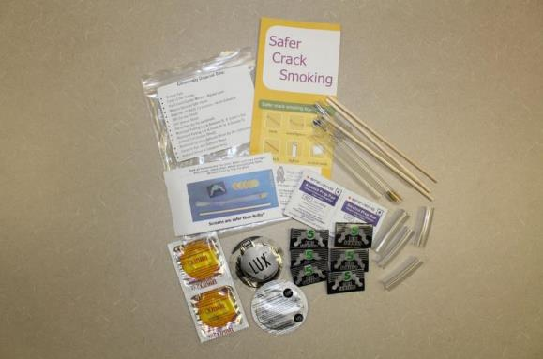
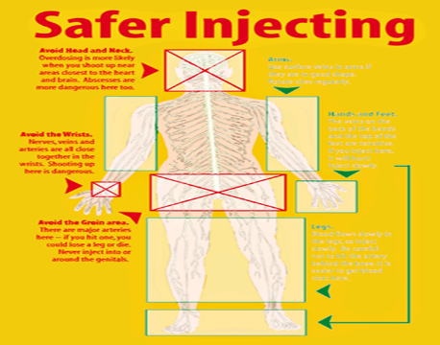
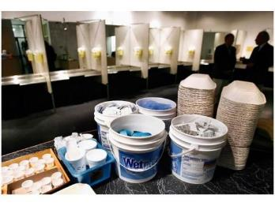
Harm Reduction Initiatives include:
Notes:
Some examples of harm reduction.
Harm reduction initiatives are a set of practical and compassionate strategies aimed at reducing the negative consequences associated with various risky behaviors, particularly substance use. These initiatives prioritize public health and safety and focus on minimizing harm rather than promoting complete abstinence. Here are some common harm reduction initiatives:
1. Needle Exchange Programs: These programs provide sterile syringes and other injection supplies to people who use drugs to reduce the risk of HIV and other bloodborne infections.
2. Supervised Injection Sites: Safe consumption spaces where individuals can use drugs under medical supervision. These sites provide access to clean injection equipment and can respond to overdoses.
3. Naloxone Distribution: Naloxone is a medication that can reverse opioid overdoses. Harm reduction initiatives involve distributing naloxone to at-risk individuals and training them on its use.
4. Safer Sex Education: Providing information and resources to promote safer sexual practices to reduce the transmission of sexually transmitted infections, including HIV.
5. Drug Checking Services: These services allow people to test the purity and content of their drugs, helping them make more informed choices and avoid harmful substances.
6. Education and Awareness: Promoting education about the risks associated with substance use, including the dangers of certain drugs and best practices for safer use.
7. Treatment Access: Making addiction treatment and mental health services more accessible, including medication-assisted treatment for opioid use disorders.
8. Housing Support: Assisting individuals in finding stable housing, which can reduce their vulnerability to the negative consequences of substance use.
9. Peer Support and Counseling: Offering peer support groups, counseling services, and therapy to help individuals address underlying issues and make healthier choices.
10. Advocacy and Policy Reform: Advocating for changes in drug policies and laws that prioritize a public health approach over a punitive one. This includes addressing issues like mandatory minimum sentences and the criminalization of drug use.
11. Community Outreach: Engaging with at-risk communities, including homeless populations, and providing access to resources and services.
12. Overdose Prevention Education: Educating individuals on recognizing the signs of an overdose and how to respond effectively, including calling for medical assistance.
13. Mental Health Support: Providing access to mental health services, which can be crucial in addressing underlying issues related to substance use.
Harm reduction initiatives are grounded in the principle of meeting individuals where they are in their substance use journey, respecting their autonomy, and aiming to reduce harm even when complete abstinence is not immediately achievable. These initiatives play a vital role in improving public health, reducing the negative consequences of substance use, and promoting overall well-being.

Slide 18
Decisional Balance
Negative Consequence of Taking the Action (Change Behavior):
1. Relapse: One potential negative outcome could be experiencing a relapse, where a return to substance use occurs despite initial efforts at change. This can be disheartening but is a common part of the recovery process.
Notes:
decisional balance that includes pros and cons for not changing current behavior (i.e., maintaining current substance use) and for changing current behavior (i.e., seeking harm reduction or treatment). I'll also include a potential negative consequence of taking the action in the "change behavior" section.
Examples on the next slide

Slide 19
Decisional Balance
. Immediate Gratification: Continuing to use substances may provide short-term pleasure or relief from stress.
2. Familiarity: Staying in the current behavior is familiar and may feel comfortable.
3. Avoidance of Withdrawal: Not changing behavior can avoid the discomfort of withdrawal symptoms.
1. Health Improvement: Seeking harm reduction or treatment can improve physical and mental health, leading to a better quality of life.
2. Reduced Legal Risks: It can minimize legal problems and prevent potential criminal consequences.
3. Recovery Support: Treatment offers access to counseling, support groups, and recovery services that can help overcome addiction.
4. Community and Family Reconnection: Getting help can rebuild strained relationships and strengthen social connections.
Negative Consequence of Taking the Action (Change Behavior):
1. Relapse: One potential negative outcome could be experiencing a relapse, where a return to substance use occurs despite initial efforts at change. This can be disheartening but is a common part of the recovery process.
1. Health Risks: Prolonged substance use can lead to serious health problems, including addiction, overdose, and chronic diseases.
2. Legal Consequences: Continued use might lead to legal issues, such as arrests and convictions for drug-related offenses.
3. Damage to Relationships: Substance use can strain relationships with family and friends.
4. Financial Costs: Sustaining the habit can be expensive and may lead to financial hardship.
1. Initial Discomfort: The process of change, especially withdrawal or detox, may be physically and emotionally uncomfortable.
2. Uncertainty: There may be uncertainty about the effectiveness of harm reduction or treatment programs.
3. Social Challenges: It might involve distancing from social circles that encourage substance use, which can be isolating.
4. Time and Commitment: Treatment can be time-consuming and may require a long-term commitment to recovery.
Notes:
decisional balance that includes pros and cons for not changing current behavior (i.e., maintaining current substance use) and for changing current behavior (i.e., seeking harm reduction or treatment). I'll also include a potential negative consequence of taking the action in the "change behavior" section.
Not Changing Current Behavior (Continuing Substance Use):
Pros:
1. Immediate Gratification: Continuing to use substances may provide short-term pleasure or relief from stress.
2. Familiarity: Staying in the current behavior is familiar and may feel comfortable.
3. Avoidance of Withdrawal: Not changing behavior can avoid the discomfort of withdrawal symptoms.
Cons:
1. Health Risks: Prolonged substance use can lead to serious health problems, including addiction, overdose, and chronic diseases.
2. Legal Consequences: Continued use might lead to legal issues, such as arrests and convictions for drug-related offenses.
3. Damage to Relationships: Substance use can strain relationships with family and friends.
4. Financial Costs: Sustaining the habit can be expensive and may lead to financial hardship.
Changing Current Behavior (Seeking Harm Reduction or Treatment):
Pros:
1. Health Improvement: Seeking harm reduction or treatment can improve physical and mental health, leading to a better quality of life.
2. Reduced Legal Risks: It can minimize legal problems and prevent potential criminal consequences.
3. Recovery Support: Treatment offers access to counseling, support groups, and recovery services that can help overcome addiction.
4. Community and Family Reconnection: Getting help can rebuild strained relationships and strengthen social connections.
Cons:
1. Initial Discomfort: The process of change, especially withdrawal or detox, may be physically and emotionally uncomfortable.
2. Uncertainty: There may be uncertainty about the effectiveness of harm reduction or treatment programs.
3. Social Challenges: It might involve distancing from social circles that encourage substance use, which can be isolating.
4. Time and Commitment: Treatment can be time-consuming and may require a long-term commitment to recovery.
Negative Consequence of Taking the Action (Change Behavior):
1. Relapse: One potential negative outcome could be experiencing a relapse, where a return to substance use occurs despite initial efforts at change. This can be disheartening but is a common part of the recovery process.
This decisional balance is a tool to help individuals and communities assess the pros and cons of changing or not changing behavior in the context of substance use. It's essential to consider individual circumstances and consult with healthcare professionals or addiction specialists when making decisions about recovery and harm reduction.

Slide 20
News Articles
http://tvo.org/article/current-affairs/shared-values/how-safe-injection-sites-really-work
http://www.theglobeandmail.com/news/british-columbia/the-arguments-for-and-against-vancouvers-supervised-injection-site/article596153/
http://www.macleans.ca/society/health/the-debate-over-safe-injection-sites/
Chrystal Meth and MSM (Tina & Slamming)

Slide 21
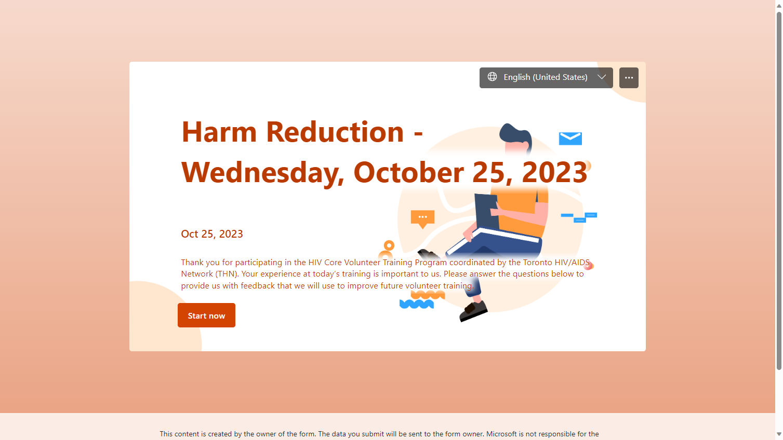
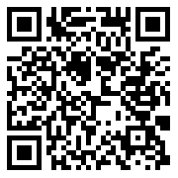
THN Volunteer HIV Core Training
Harm Reduction
Feedback
https://tinyurl.com/y5fogurf

Slide 22
