Slide 1
THN Volunteer HIV Core Training Project
Harm Reduction

Slide 2
Acknowledgements
Harm Reduction module task group members from:
Black Coalition for AIDS Prevention (Black CAP)
Queen West Community Health Centre (now Parkdale Queen West)
Ontario HIV Substance Use Training Program (OHSUTP),
Prisoners with HIV/AIDS Support Action Network (PASAN)
Ontario Aboriginal HIV/AIDS Strategy (OAHAS)
Presenter/Facilitator – Kyle Vose, Toronto People With AIDS Foundation (PWA)

Slide 3
Learning Objectives:
To increase understanding of the philosophy and practice of Harm Reduction.
To reflect upon, examine and understand our own attitudes and beliefs about people who use substances.
To increase an understanding of the stigma & discrimination faced by people who use substances.
To understand the continuum of substance use and the stages of change.

Slide 4
What is Harm Reduction?
How many here identify as a substance user?
What are some common substances?
How many of you practiced “Harm Reduction” to get to today’s training?
Notes:
Ask each question

Slide 5
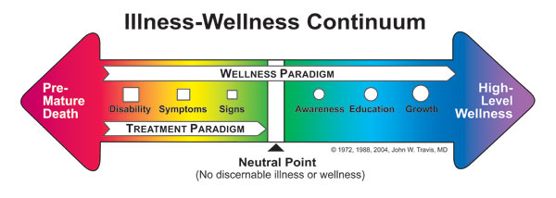
Harm reduction recognizes that there is a continuum of risk in life, as there is in substance use, sex and other activities.

Slide 6
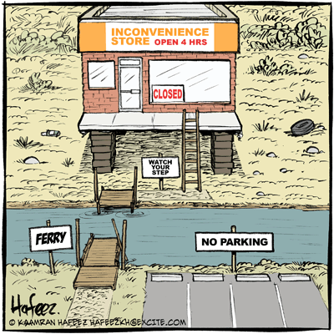
Harm Reduction provides accessible, flexible, culturally responsive and non-judgmental services for all.

Slide 7


Harm Reduction does not judge individuals on the basis of their individual behaviours

Slide 8
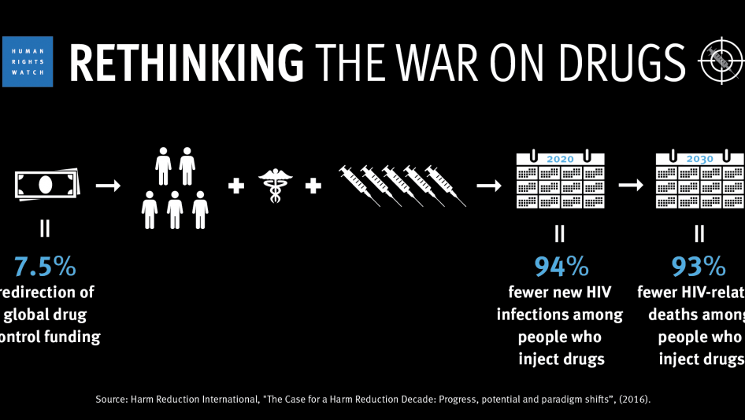
Harm reduction seeks to enhance social and health programs, disease prevention and education while minimizing repressive and punitive measures.

Slide 9

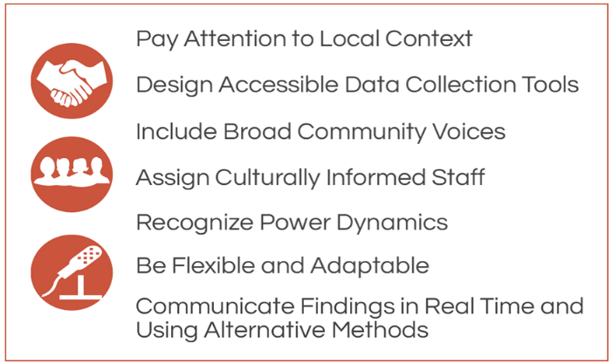

Harm reduction recognizes the right for comprehensive, accessible, flexible and culturally responsive non-judgmental social services for and the fulfillment of basic needs of all individuals and communities

Slide 10
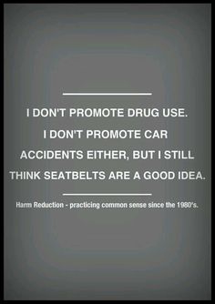
Harm reduction provides options in a non-judgmental, non-coercive way and strongly advocates that the individuals and communities affected by drug use be involved in the creation of and implementation of harm reduction interventions.

Slide 11
What Harm Reduction is NOT
About abstinence
A stepping stone to abstinence
Anti-abstinence
The best response for everyone
Does not say that drugs are good and that all behaviours
are acceptable

Slide 12
What Harm Reduction IS:
About social inclusion
About practices, programs, policies…all aimed at reducing harms associated with substance use
About legal AND illegal substances
Founded on public health and social justice
Founded on knowledge that many drug-related programs are the result of failed policy and laws
Value-based about drug use
Founded on principles of respect
Requires us to think systemically

Slide 13
How does our Language Reflect our Beliefs
Drunks”, “Alcoholics” >>> Individuals with problem alcohol use or “Alcohol users”, “substance user”.
“Druggies”, >>> “people who use drugs”
“Junkies”, “a person living with an addiction”
“Crack Heads” or “active substance users”.
“Drug Abuse”, >>> “Substance use” or
“Substance Abuse” “Problem Substance Use”.
“clean”, “dirty” >>> “new or used” equipment

Slide 14

AIVL AUSTRALIAN STIGMA & DISCRIMINATION OF INJECTION DRUG USERS
https://www.youtube.com/watch?v=ASoKlgsZPCk

Slide 15
Determinants of Health
Vulnerability Substance Use
& HIV Infection
Income and Social status
Social Support Networks
Education
Employment/Working Conditions
Social environments
Physical Environments
Personal Health Practices and Coping Skills
Healthy Child Development
Biology and Genetic Endowment
Health Sciences
Gender
Culture

Slide 16
Determinants of Health
Vulnerability to Substance Use
& HIV Infection
People use drugs for a variety of personal and systemic reasons.
Influences affecting self-worth/self-esteem:
      Grief, Loss, Bereavement
      Depression, Anxiety, Stress
      Trauma
      Social Exclusion
      Stigma
      Trauma
      Discrimination
      Homophobia
      Racism
      Loss of hope

Slide 17
Key Elements of Drug Related Stigma
Criminalise
drugs = bad get tough punish.
Incarcerating users for non-violent crime vs. resources into supportive services.

Slide 18
Key Elements of Drug Related Stigma Incarceration
Incarceration of significant numbers of drug users increases the likelihood of drug use inside prisons.
Most prisoners admit to having a substance use issue that would warrant treatment while in prison

Slide 19
Key Elements of Drug Related Stigma Incarceration
Disproportionate representation of Aboriginal peoples inside due to systemic discrimination, socio-economic deprivation and other factors
Most incarcerated women are survivors of childhood sexual abuse and/or domestic violence, and many women have been economically, racially, culturally, and sexually marginalised.

Slide 20
Key Elements of Drug Related Stigma Incarceration
Prisoners’ health is directly related to community health.
Prisoners have had a series of events that lead up to them being incarcerated.
People need community waiting for them so they don’t have to go back in to find it.

Slide 21
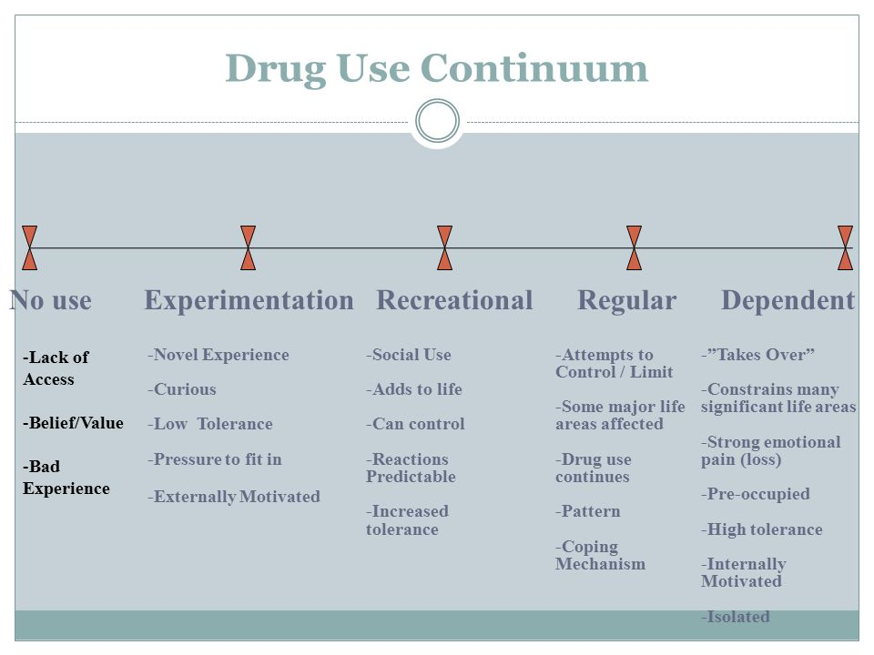
D
Notes:
Use this model as an example to show where on this model for three or four different substances where a person may fall

Slide 22
Harm Reduction Continuum
Make Supplies Available
Engage with People
Identify Barriers to use (person, community)
Help overcome barriers (networking, referral)
Encourage and support progress
Notes:
Start out with Make supplies available (condoms or handing out harm reduction), engage with people (starts conversation), Identify Barriers (hear they are homeless), Overcome barriers (referrers to housing worker), Encourage and support progress (non-judgemental and agency implements partnership with other agencies)

Slide 23
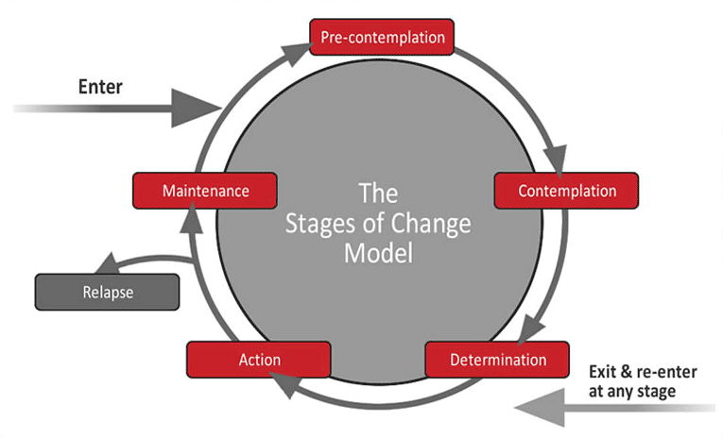
Stages of Change Model
Notes:
Use an example like dieting or quite smoking. Remember relapse can happen at every and any stage!

Slide 24
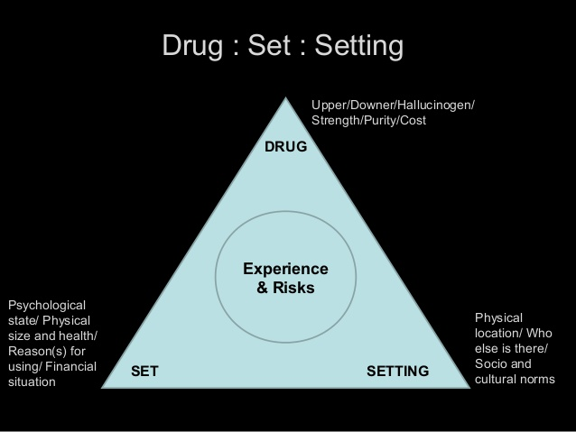
Notes:
Explain how changing one of these can change how the drug can affect a person

Slide 25

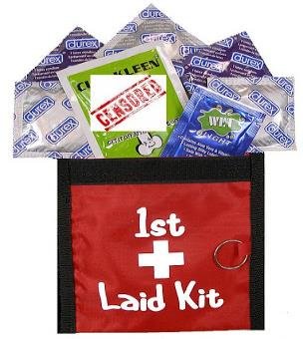
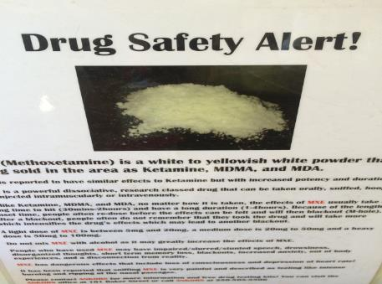
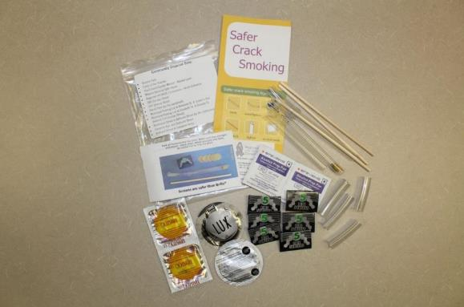
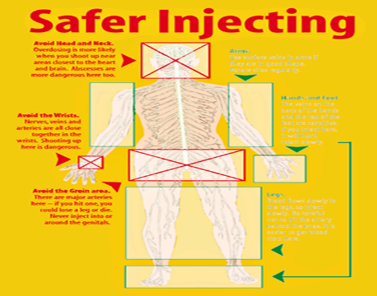
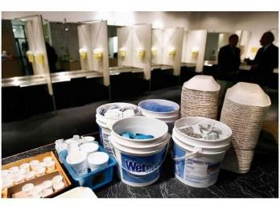
Harm Reduction Initiatives include:
Notes:
Some examples of harm reduction.

Slide 26
Benefits of Harm Reduction
Reduces risk of harm to individuals
Safer neighbourhoods
Police and legal system resources shift to safety priorities
Less money on the healthcare system
Allows emergency services to focus on other health
concerns

Slide 27
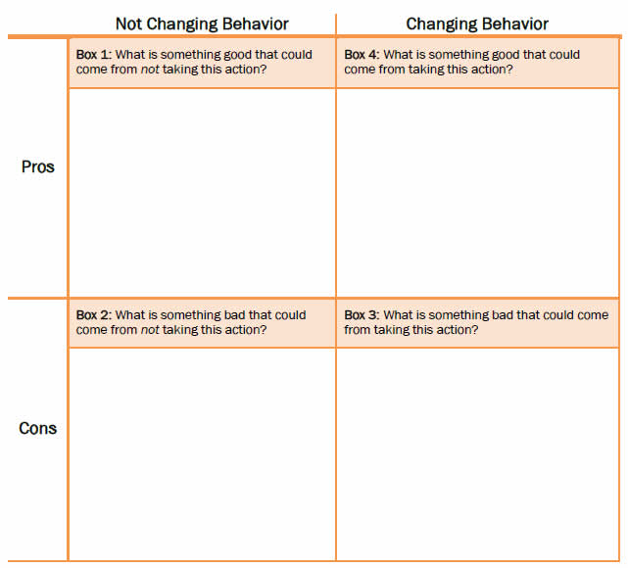
Decisional Balance

Slide 28
Harm Reduction practices
Create a Harm reduction plan for each of the following:
  Your clothes don’t fit as you have gained weight.
  You have to go to work with a horrible cold.
  A smoker comes to you and wants to reduce the risk of smoking.
  Going out to a club drinking.
  Someone discloses that they are an injection drug user.

Slide 29
News Articles
http://tvo.org/article/current-affairs/shared-values/how-safe-injection-sites-really-work
http://www.theglobeandmail.com/news/british-columbia/the-arguments-for-and-against-vancouvers-supervised-injection-site/article596153/
http://www.macleans.ca/society/health/the-debate-over-safe-injection-sites/

Slide 30
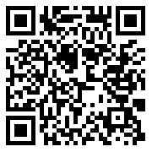
THN Volunteer HIV Core Training
Harm Reduction
Feedback
https://tinyurl.com/y5fogurf

